Slide 1
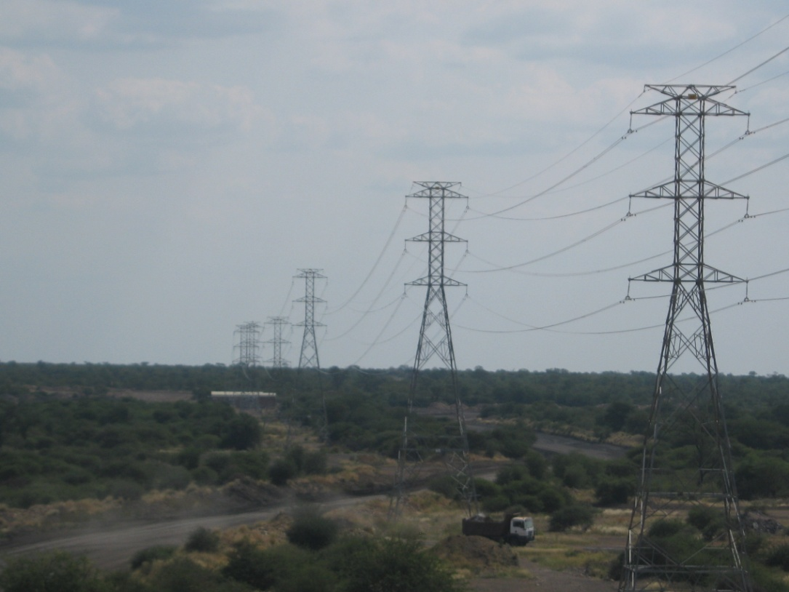
Lightning induced over-voltages on a power lines

Slide 2
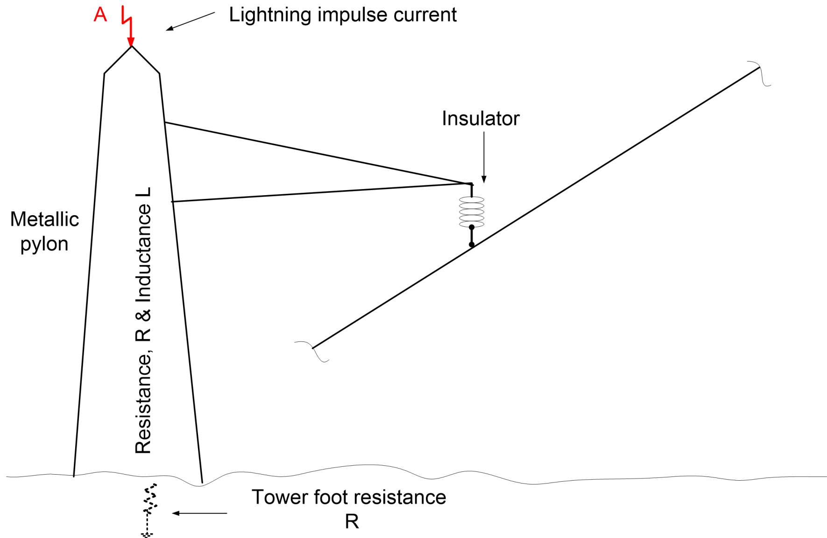
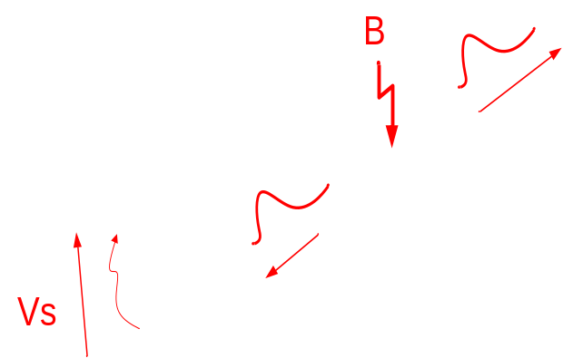
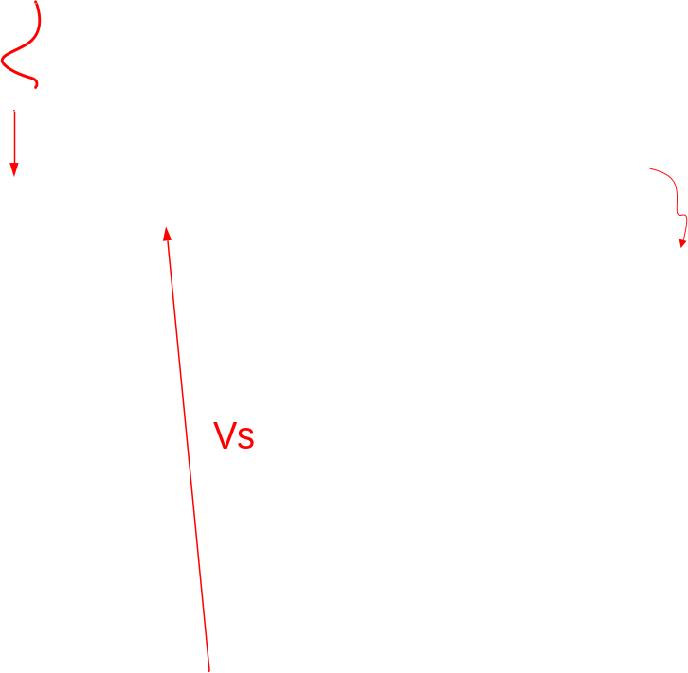
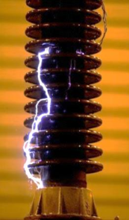
Lightning voltage surge build up on a power line

Slide 3
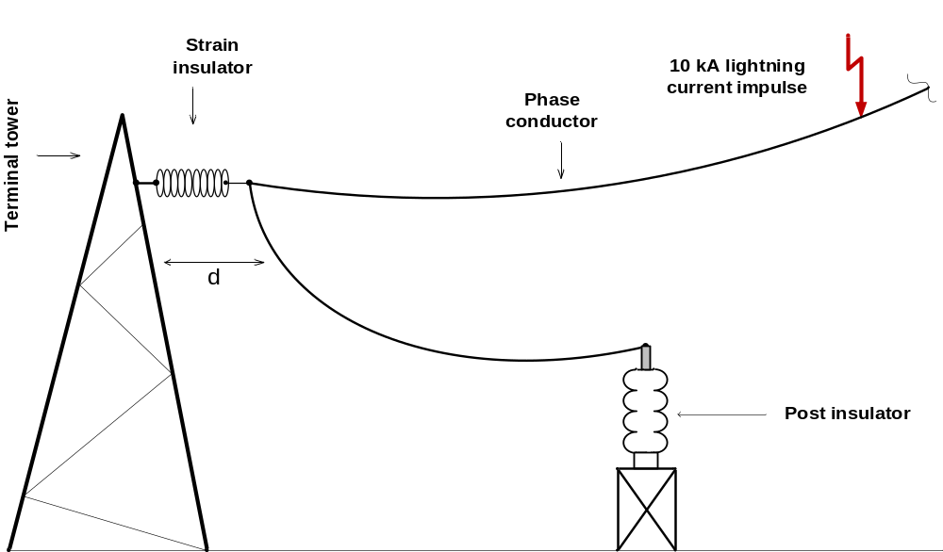
Travelling wave phenomena of transient over-voltages on transmission lines

Slide 4
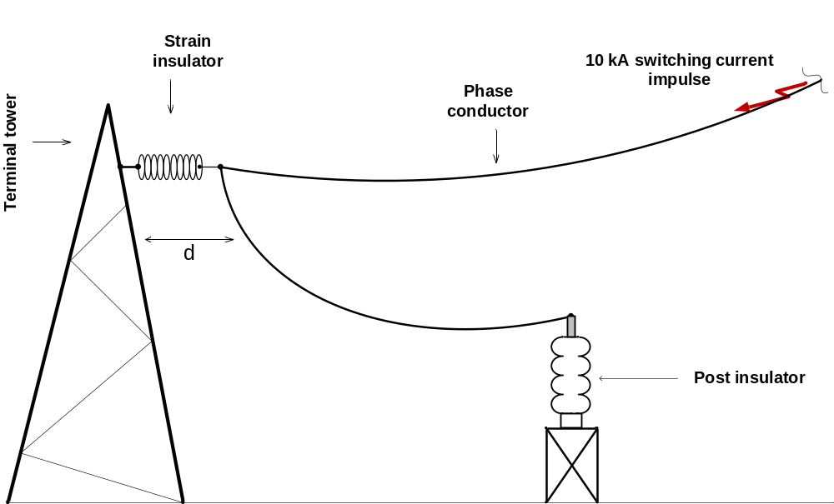
Travelling wave phenomena of transient over-voltages on transmission lines

Slide 5
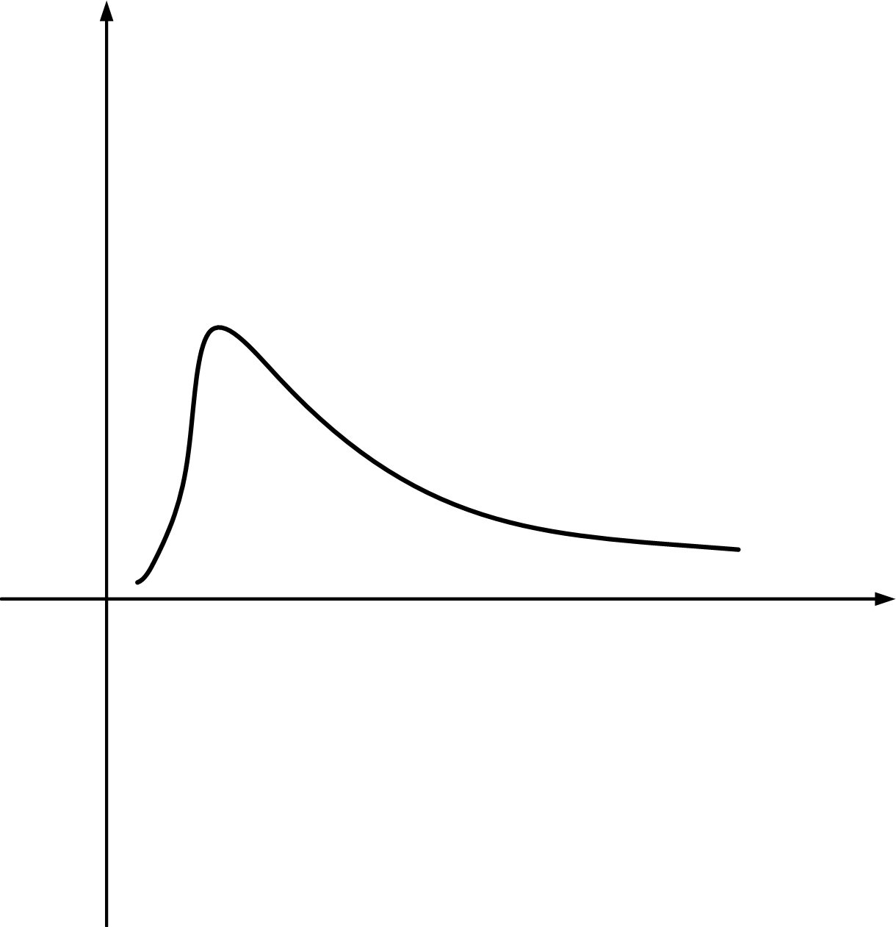
Breakdown under impulse voltage is statistical phenomenon
Voltage (V)
Impulse voltage wave
Time (µs)

Slide 6
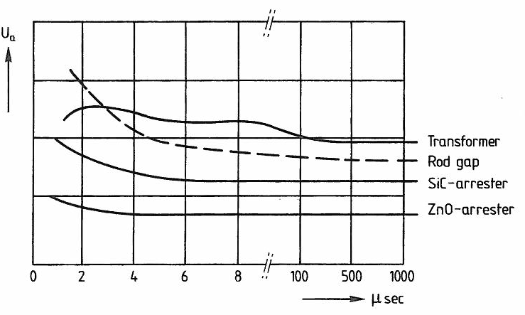
V-t curves for devices

Slide 7
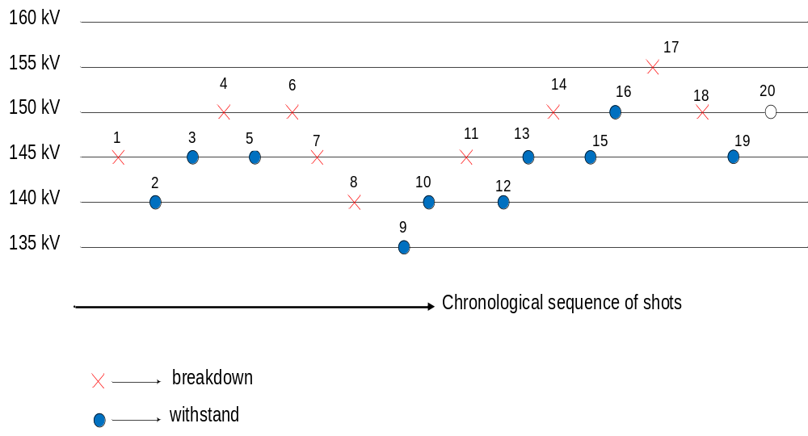
U50 up-down method

Slide 8
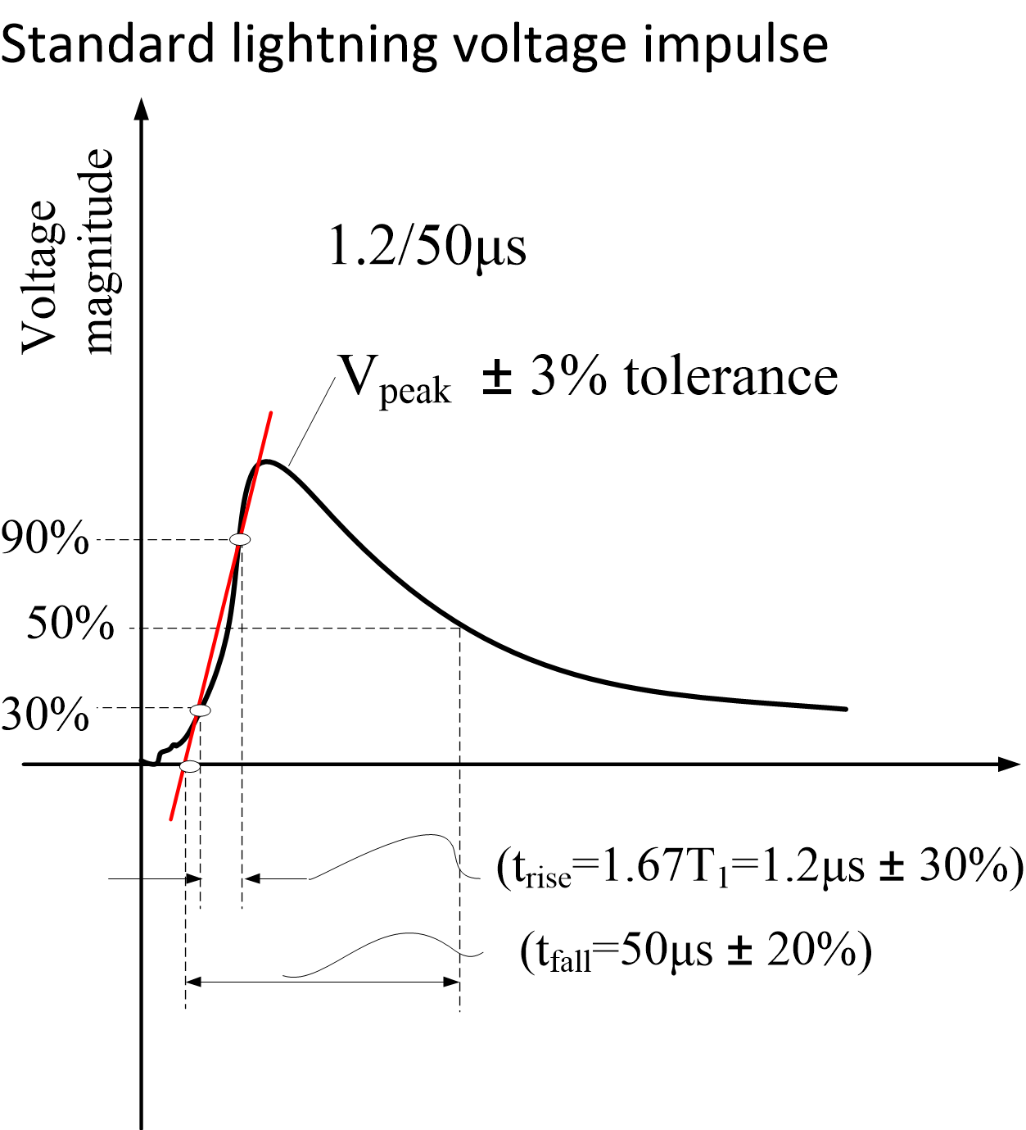

Slide 9
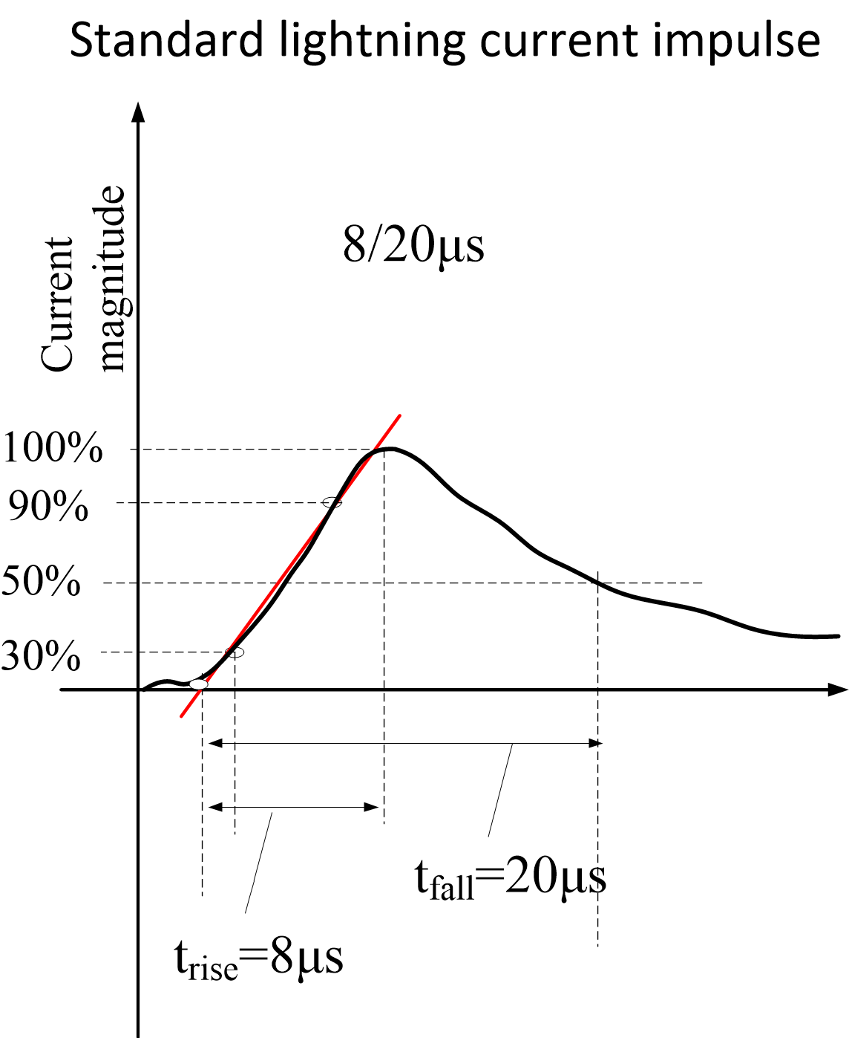

Slide 10
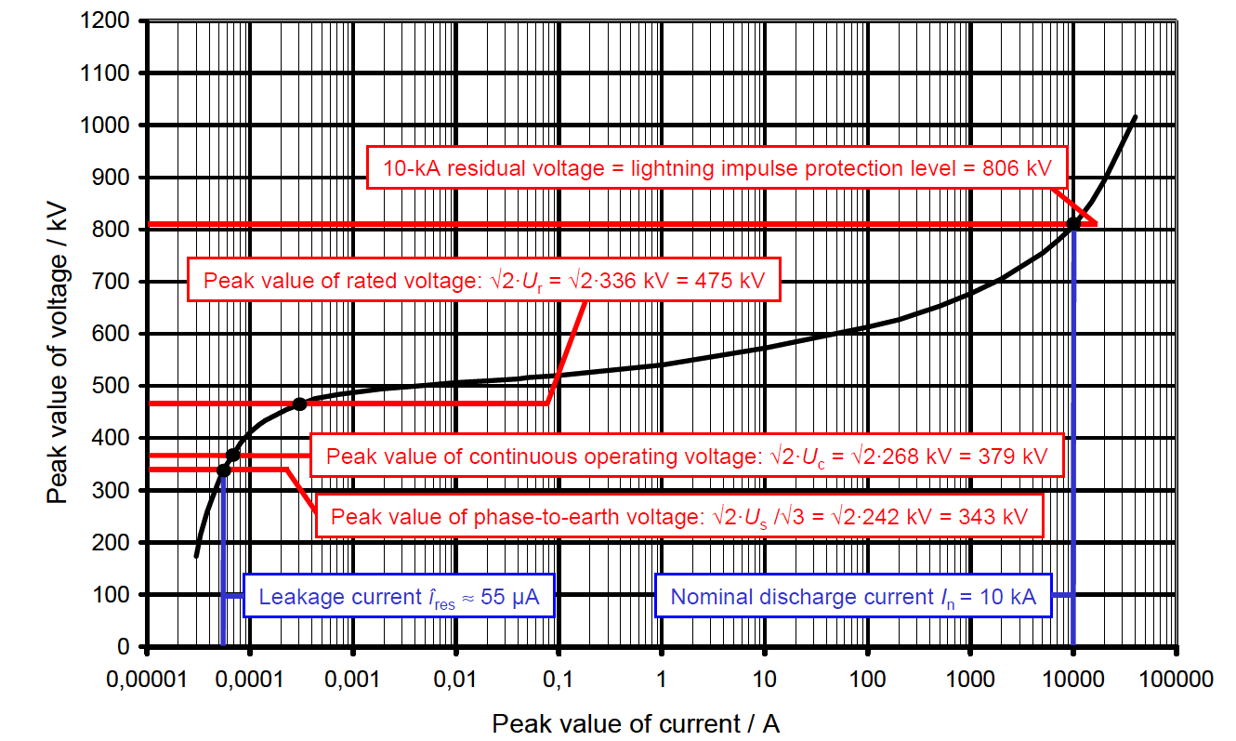
An example of a MO Arrester U-I curve

Slide 11
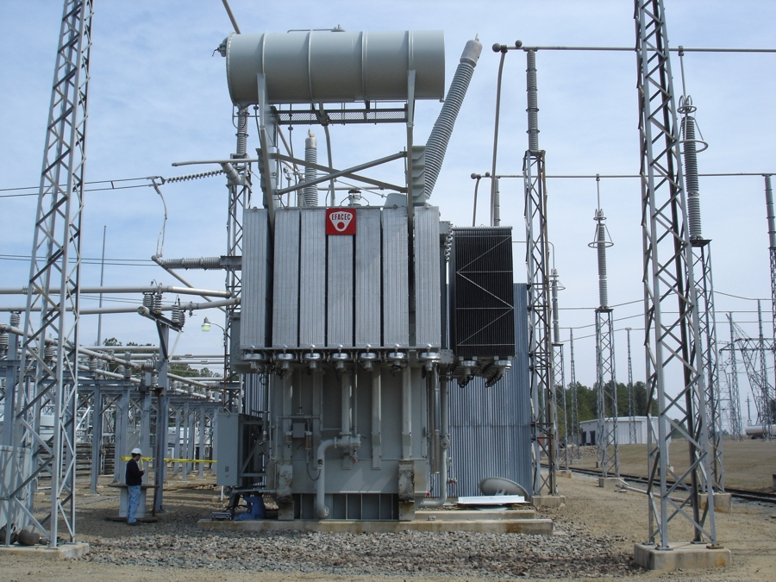
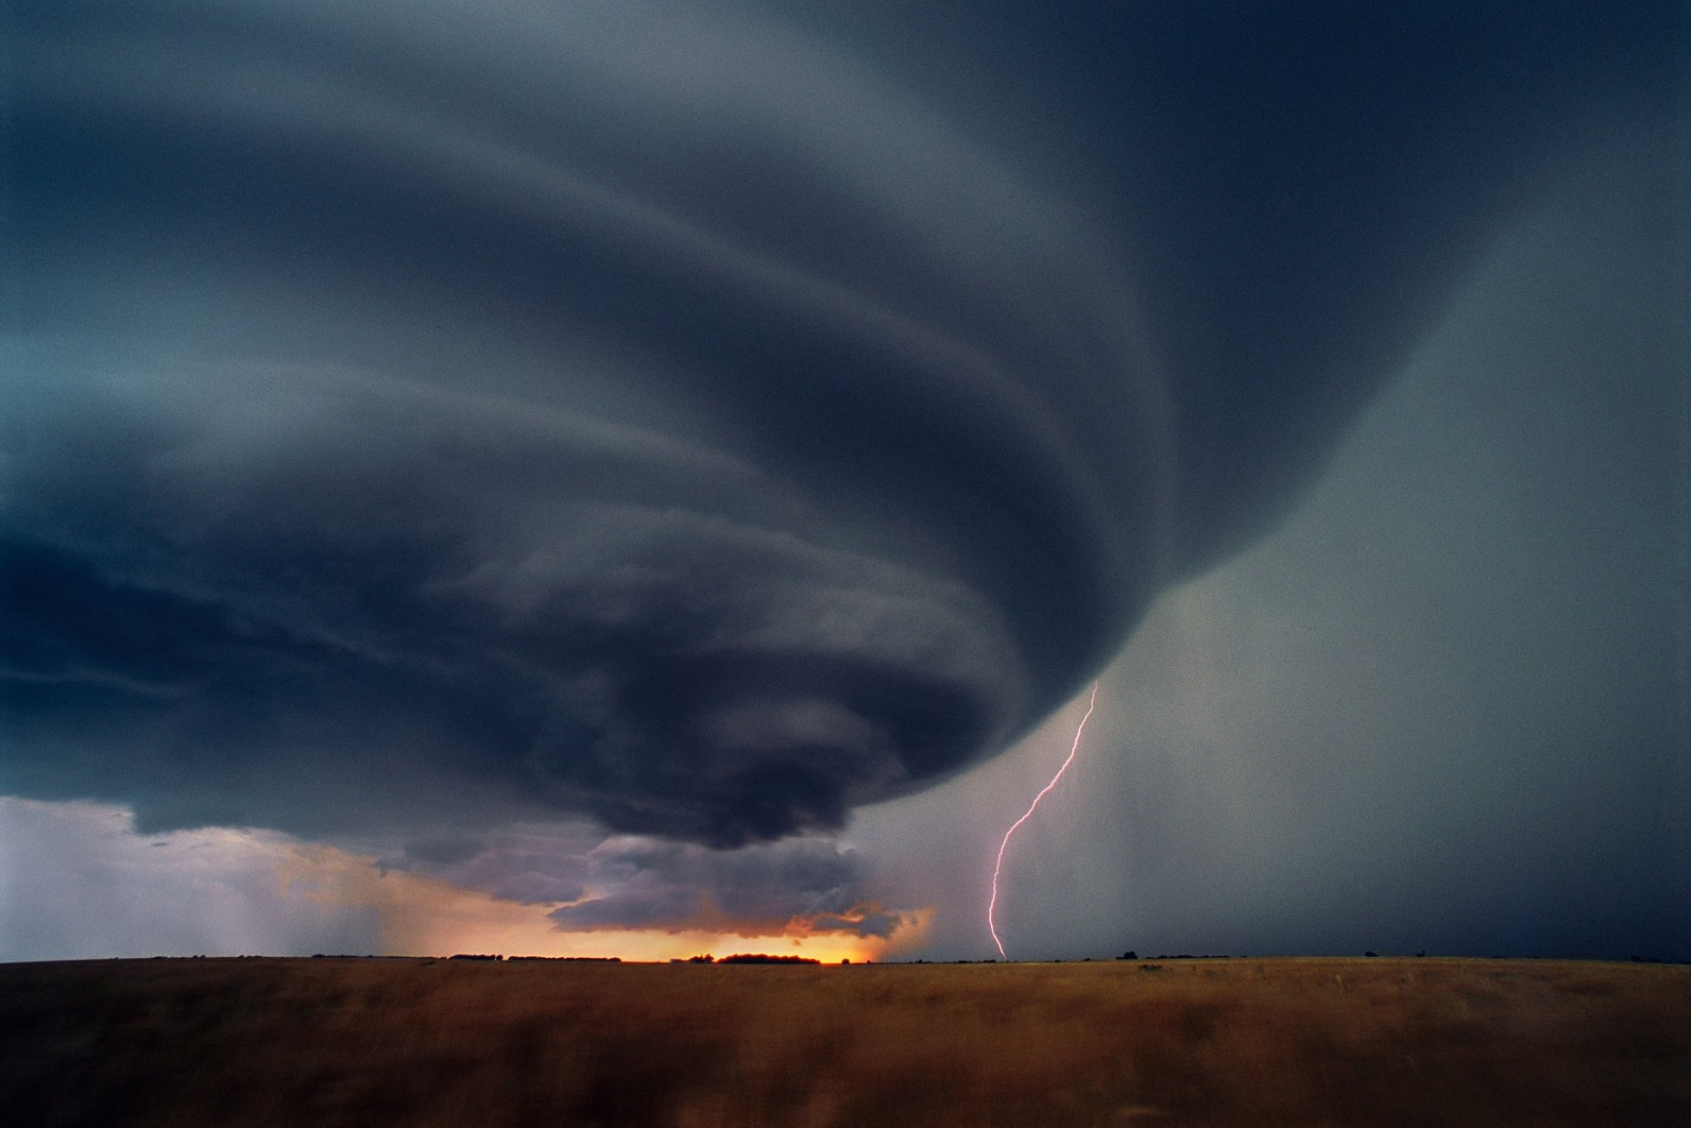

Slide 12
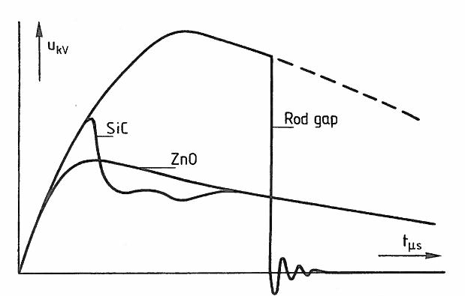
Diverting a lightning voltage wave by 3 different devices

